Slide 1
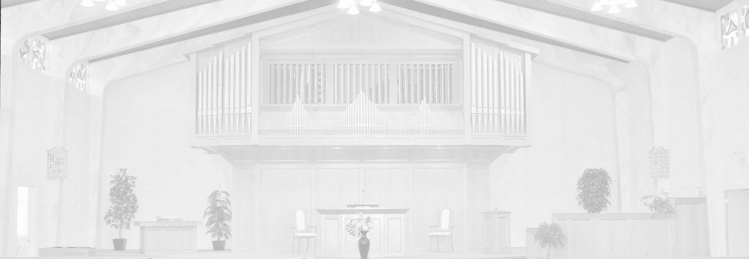
Cornerstone United Reformed Church of Edmonton
2026-03-05, Morning Service
Genesis 49:29 – 50:14
“A Burial Fit for a King”
Pastor Vander Lei

Slide 2
#27B Jehovah is My Light
1. Jehovah is my light And my salvation near; Who shall my soul affright Or cause my heart to fear? While God my strength, my life sustains, Secure from fear my soul remains.
Copyright Crown and Covenant Publications

Slide 3
2. When evildoers came to make my life their prey, they stumbled in their shame and fell in deep dismay; though hosts make war on ev’ry side, still fearless I in God confide.

Slide 4
3. My one request has been, And still this pray’r I raise, That I may dwell within God’s house through all my days, Jehovah’s beauty to admire And in his temple to inquire.

Slide 5
4. When troubles round me swell, when fears and dangers throng, securely I will dwell in his pavilion strong; within the shelter of his tent he hides me ‘til the storm is spent.

Slide 6
5. Uplifted on a rock Above my foes around, Amid the battle shock My song shall still resound; Then joyful off’rings I will bring, Jehovah’s praise my heart shall sing.

Slide 7
#156 Christ, Whose Glory Fills the Skies
1. Christ, whose glory fills the skies, Christ, the true, the only Light, Sun of Righteousness, arise, triumph o'er the shades of night; Dayspring from on high, be near; Daystar, in my heart appear.
Copyright Trinity Psalter Hymnal, 2018, used by permission

Slide 8
2. Dark and cheerless is the morn unaccompanied by thee; joyless is the day's return 'til thy mercy's beams I see; 'til they inward light impart, glad my eyes, and warm my heart.

Slide 9
3. Visit, then, this soul of mine; pierce the gloom of sin and grief; fill me, Radiancy divine; scatter all my unbelief; more and more thyself display, shining to the perfect day.

Slide 10
#42C As Thirsts the Hart for Water Brooks
1. As thirsts the hart for water brooks, so thirsts my soul, O God for thee; it seeks for God, and ever looks and longs the living God to see, and longs the living God to see.
Copyright Trinity Psalter Hymnal, 2018, used by permission

Slide 11
2. Far from the courts of God, my tears have been my food by night and day, while constantly with bitter sneers, "Where is thy God?" the scoffers say, "Where is thy God?" the scoffers say.

Slide 12
3. With grief I think of days gone by, when oft I trod the hallowed way to Zion, praising God on high with throngs who kept the holy day, with throngs who kept the holy day.

Slide 13
4. O why art thou cast down, my soul, and why so troubled shouldst thou be? Hope thou in God, and him extol, who gives his saving help to me, who gives his saving help to me.

Slide 14
#476 It Is Well with My Soul
1. When peace, like a river, attendeth my way, when sorrows like sea billows roll; whatever my lot, thou hast taught me to say, It is well , it is well with my soul

Slide 15
2. Though Satain should buffet, though trials should come, let this blest assurance control, that Christ has regarded my helpless estate, and has shed his own blood for my soul.

Slide 16
3. My sin - O the bliss of this glorious thought! my sin not in part, but the whole, is nailed to the cross and I bear it no more; praise the Lord, praise the Lord, O my soul!

Slide 17
4. O Lord, haste the day when my faith shall be sight, the clouds be rolled back as a scroll; the trump shall resound, and the Lord shall descend; Even so it is well with my soul.

Slide 18
Offerings
Budget
Reformed Missions—Costa Rica
Giving details have been provided to members. Others who may wish to give may contact the church for additional details.

Slide 19
#27B Jehovah is My Light
7. Hide not your face from me, your servant, Lord, I pray; since you have been my help, O turn me not away! In anger do not cast me off. My Savior God, forsake me not.
Copyright Crown and Covenant Publications

Slide 20
10. I certainly believe that I will surely see the goodness of the Lord with those that living be! O wait for God! Be strong in faith. Be bold of heart; the Lord await.

